Slide 1
MSCS 621 – Fall 2019
Final Project - Leantime
By Mamun Kaiyum

Slide 2

INTRODUCTION
This project is based on Leantime, an open source solution, for project managers, the main purpose on this development is containerize this application and deploy it in two different cloud environments. The following slides will let you know more about Leantime, and the plan and architecture of these deployments.

Slide 3
LEANTIME
Successful projects needs proactive project managers in every stage of the way. Leantime is an application built for small teams and startups. It provides a very intuitive user interface, that helps users with different kind of management tasks and activities.
MAIN OBJECTIVES
Increase Product Quality
(idea Manager, Research Manager)
Break Down Work
(Gantt Chart, Milestone Tracking)
Manage Change
(Backlog)

Slide 4
FEATURES
Project dashboards
Task management using Kanban boards, list and calendar views
Milestone management using Gantt charts
Idea boards
Timesheet management
Multiple user roles (client, developer, manager, admin)
Integrations with Mattermost & Slack

Slide 5
DEPENDENCIES
To deploy this project successfully you need to meet the following requirements:
Ubuntu 18.04 / Windows 10 Pro (Any other O.S that is supported by Docker) Git Docker Docker Compose

Slide 6
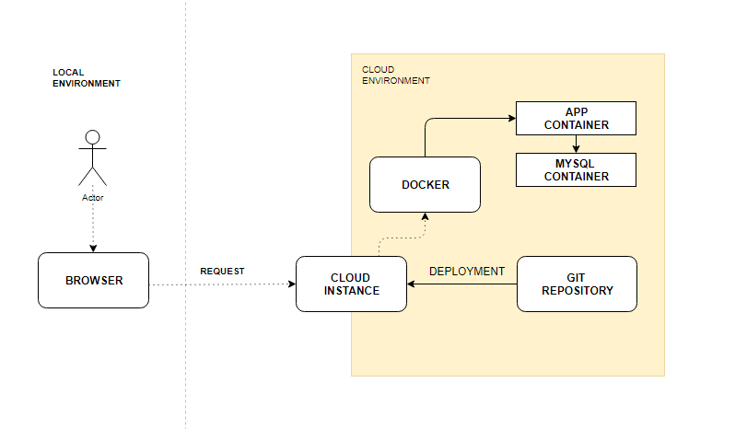

ARCHITECTURE
Both cloud environments will have deployed the same components. Docker will be used as main frontend service that will capture the requests from users and redirect it to the app container.
MySQL container will be used by the app to retrieve and save information every time users requests any of these actions.

Slide 7
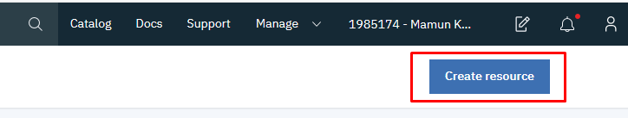
DOCKER DEPLOYMENT ON IBM CLOUD
In the Dashboard select the option, “Create Resource”

Slide 8
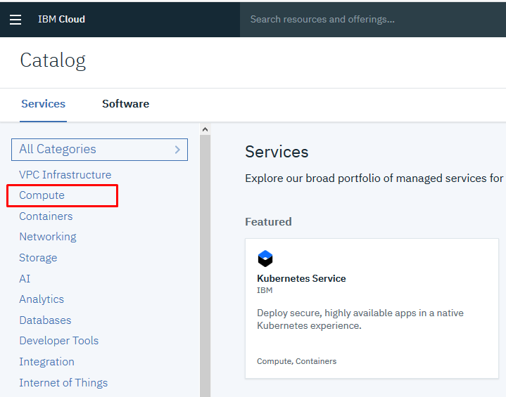
DOCKER DEPLOYMENT ON IBM CLOUD
Select the “Compute” option in the main menu.

Slide 9
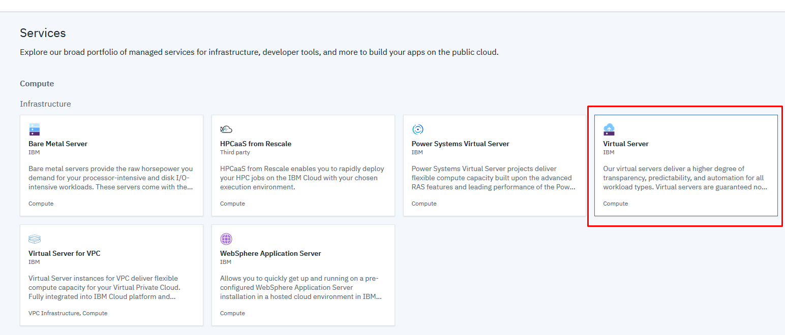
DOCKER DEPLOYMENT ON IBM CLOUD
Select the “Virtual Server” option in the main menu.

Slide 10
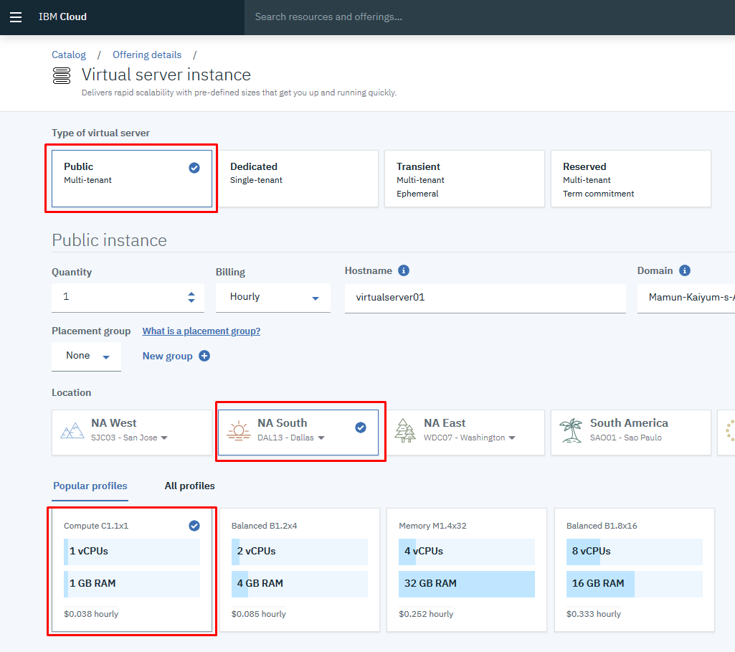
DOCKER DEPLOYMENT ON IBM CLOUD
Select “Public” to allow users the access
the application.
Select the location for the server deployment.
Select the hardware profile that you need for the server.

Slide 11
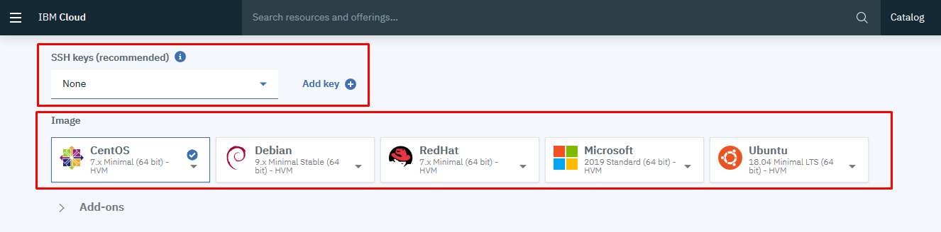
DOCKER DEPLOYMENT ON IBM CLOUD
Select “Add Key” to add your key to the server, this way you will gain access to server to start the deployment procedure.
Once added you can click on “Create” button to start the deployment of your server.

Slide 12
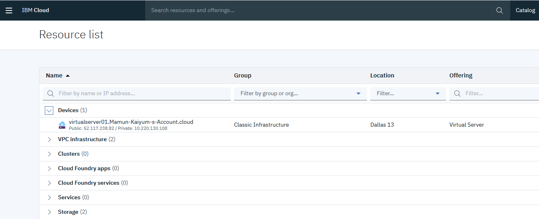
DOCKER DEPLOYMENT ON IBM CLOUD
In the device section, the instance should appear deployed.

Slide 13
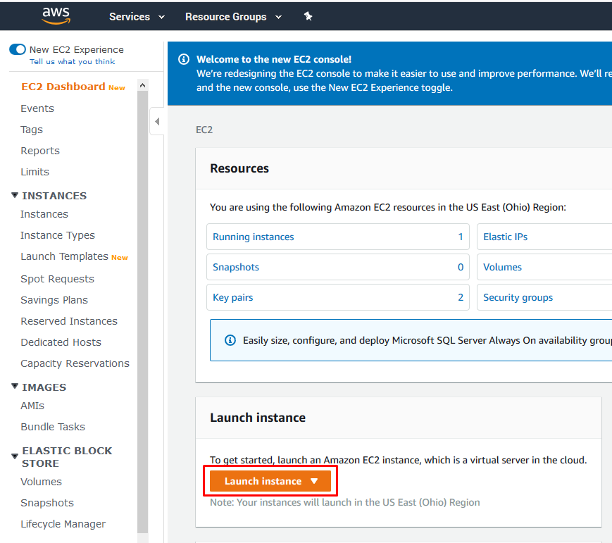
DOCKER DEPLOYMENT ON AWS
Head over to the EC2 Dashboard and click on the "Launch Instance" Button

Slide 14
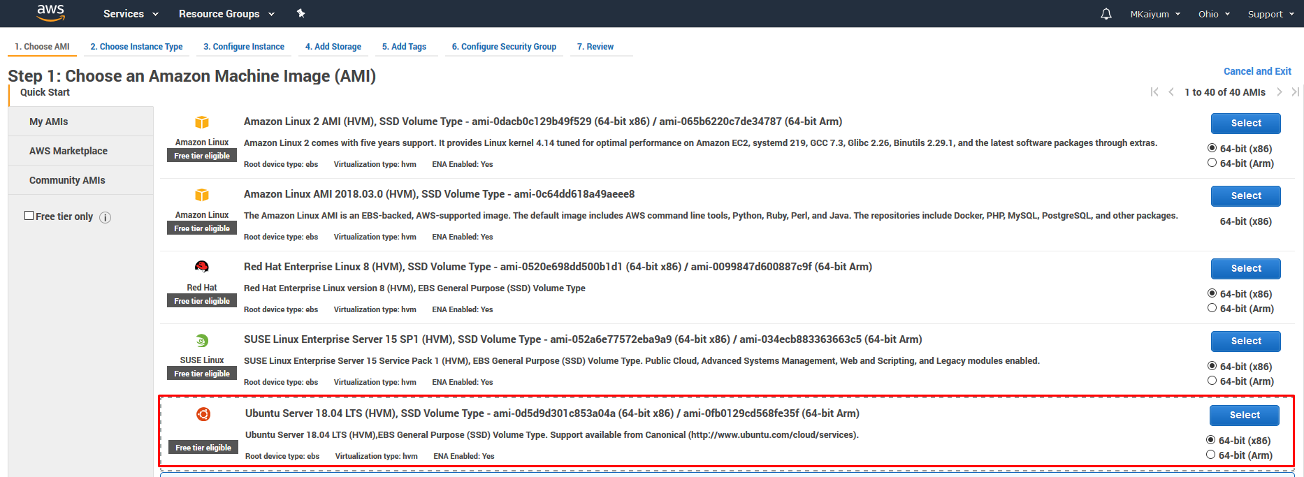
DOCKER DEPLOYMENT ON AWS
Select "Ubuntu Server 18.04" as Operating System

Slide 15
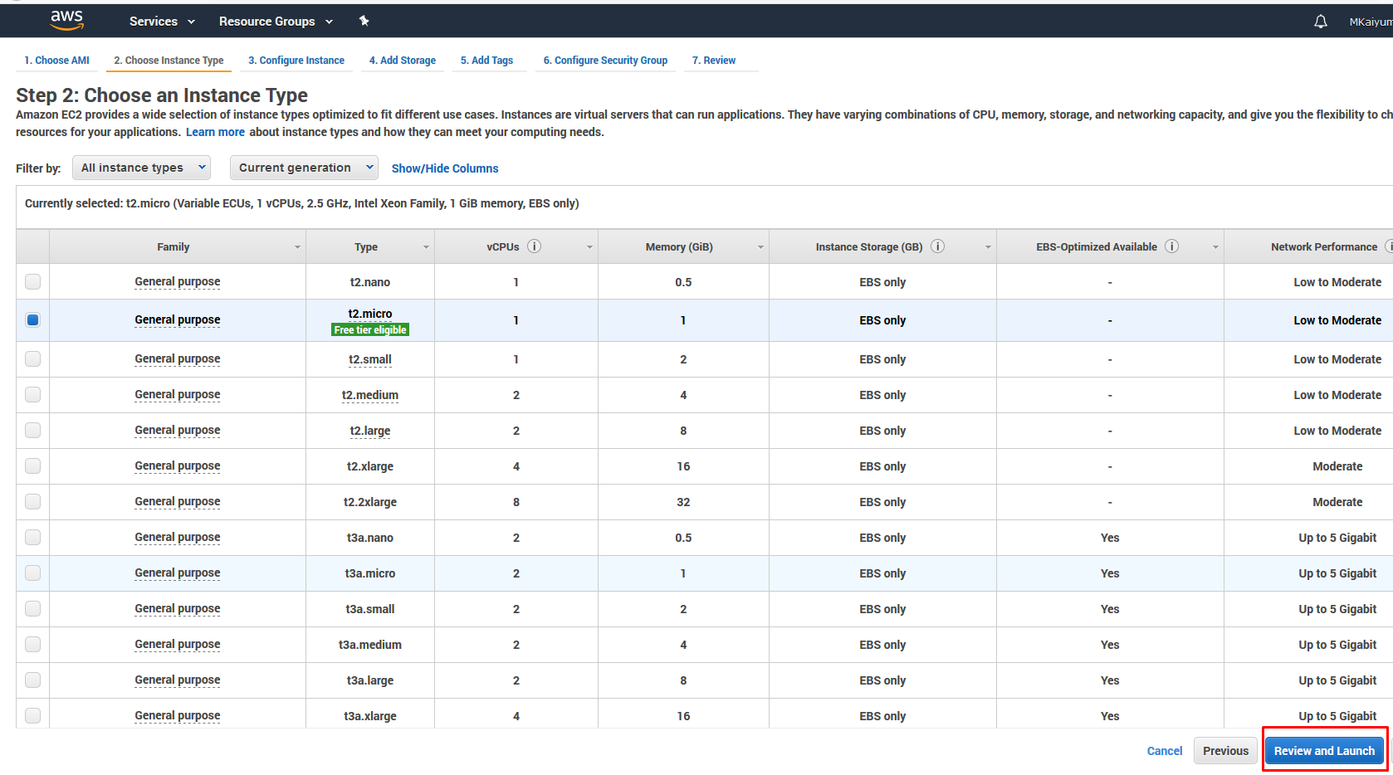
DOCKER DEPLOYMENT ON AWS
Choose the instance type and Click on "Review and Launch"

Slide 16
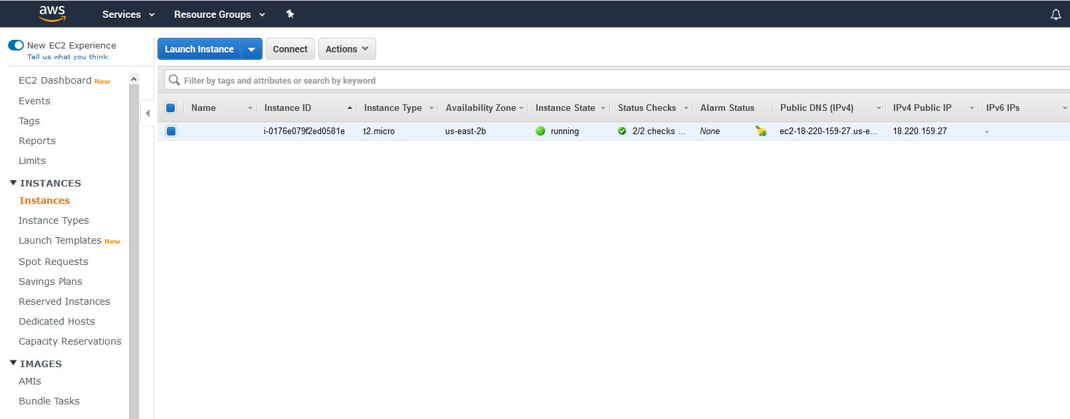
DOCKER DEPLOYMENT ON AWS
Check EC2 Instances to get the Public IP Address and continue the configuration

Slide 17
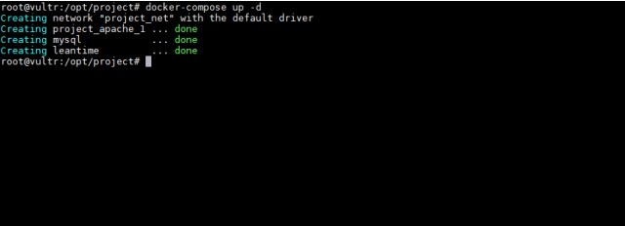
DOCKER DEPLOYMENT
Once the server is deployed, login using SSH, and follow the next steps:
git pull the repository
cp .env.sample .env
deploying the project (docker-compose up -d)

Slide 18
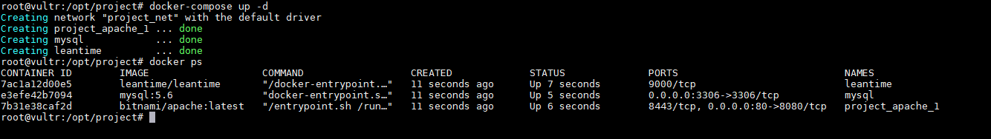
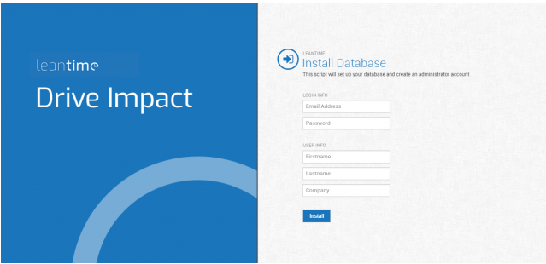
CONFIGURING THE APPLICATION
Once the project is deployed, check containers are running with command (docker ps)
you can go to http://HOST_ADDRESS/install, so you can proceed with the installation procedure:

Slide 19
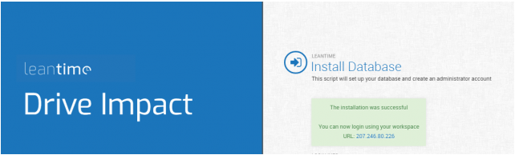
CONFIGURING THE APPLICATION
Once the process has finished a message like this should appear in the screen. This will confirm that the process ended successfully.

Slide 20
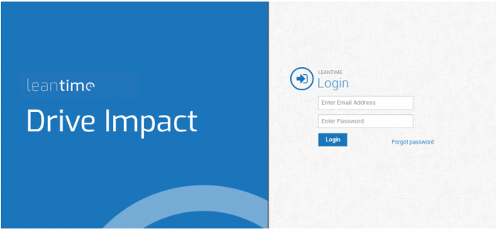
CONFIGURING THE APPLICATION
You can now go to the main page: http://HOST_ADDRESS, and login into the system.

Slide 21
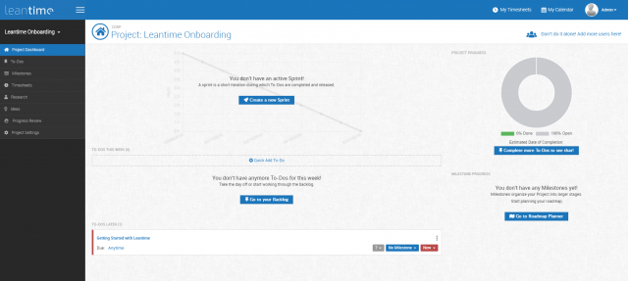
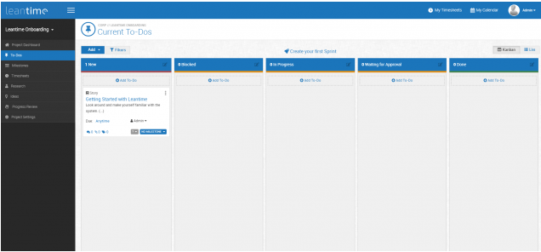
CONFIGURING THE APPLICATION
Once login into the system, you can access the main interface, and play with all features of the application:

Slide 22
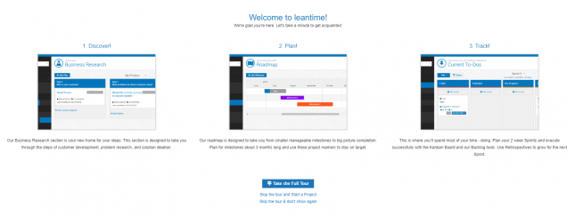
CONFIGURING THE APPLICATION
Cloud Deployments
http://leantimeapp.ddns.net
Username: admin@example.com Password: 321.qwerty
http://leantimeapp-aws.ddns.net

Slide 23
How is this different than the Original Github Project?
This application is hybrid as it is deployed on two different hybrid cloud environment
IBM Cloud services
AWS Cloud services
The application is deployed in the local host using virtual box and docker.
The application is containerized .

Slide 24
SOURCES
Leantime (2019). Retrieved from https://leantime.io
Docker (2019). Retrieved from https://docs.docker.com
Repositories
https://github.com/Leantime/leantime https://github.com/MKaiyum/marist-mscs621-2019-MamunProject
https://hub.docker.com/repository/docker/mamunmscs/leantime

